Slide 1
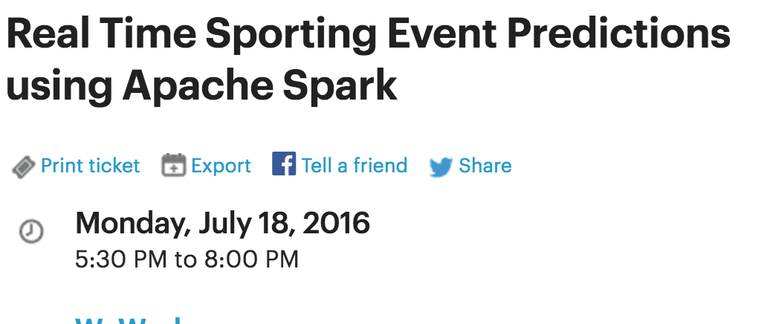
Big Data Developers Meetup
Presenter : Dustin VanStee
IBM Open Source Solution Engineer
Twitter : @dustinvanstee
LinkedIn : https://www.linkedin.com/in/dustinvanstee

Slide 2
Meetup Agenda
Use case overview
Quick Web Demo
Data Flow and Architecture
Tools used for the project
Spark / ML Quick Review
Use Case Deep Dive
Data wrangling
Some Visualizations
Logistic Regression
Unlock ML models for Insights
Bluemix and Node.js highlights
Review some code
Demo web application

Slide 3
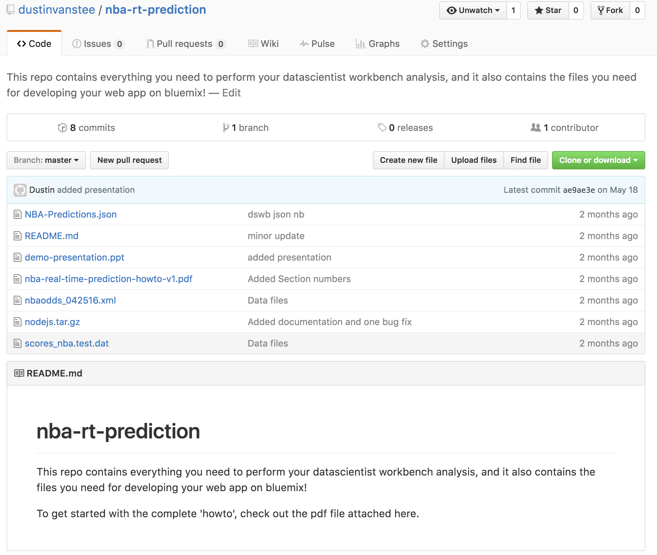
All the source from today’s presentation is posted on Github!
https://github.com/dustinvanstee/nba-rt-prediction

Slide 4


Use Case
Goal : To provide analytics for ”Acme Co” that takes current NBA game status and implements a real time win/loss prediction and probability system using machine learning
What is the probability the Cavs or Warriors will win during the game ?
Are there other data sources that can help … ?
Are there other analytics we can show ….?

Slide 5
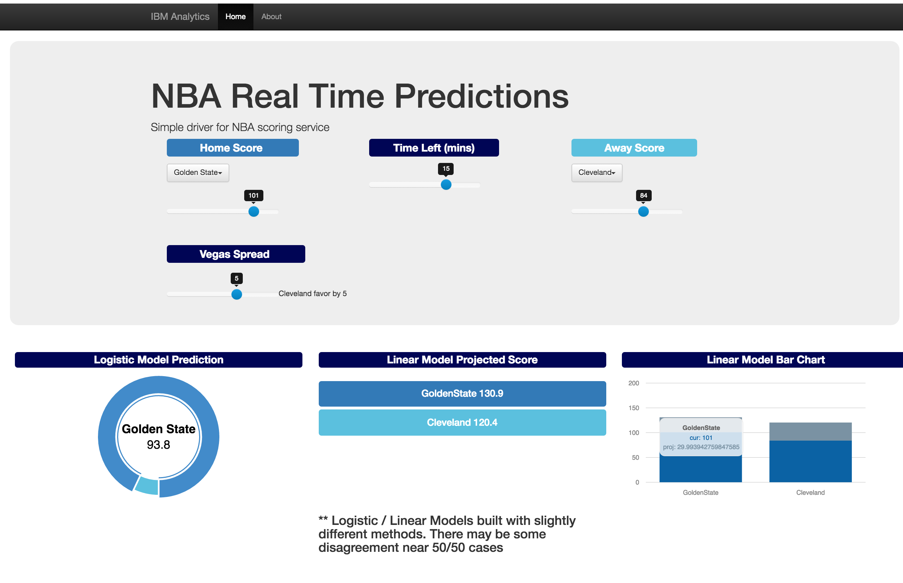
nba-rt-prediction.mybluemix.net
Winner probability
Logistic Regression
Final Score Bar Chart
Home Team Final Score
Linear Regression
Away Team Final Score
Linear Regression
Score service → http://nba-rt-prediction.mybluemix.net/scorepredictionv2/25/23/36/219/-1.5

Slide 6
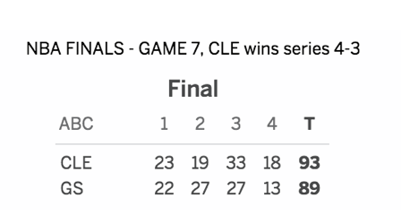
Online app demo
Browse to this URL and give is a try
http://nba-rt-prediction.mybluemix.net/
Some examples
Whats the chances Cleveland would win after the first quarter?
How does the vegas spread change the odds of winning
Whats the projected score? Was it close to the final ?
** Disclaimer **
This model was built using 100 games from the month of April. Logistic probability and Linear score predictions were built using slightly different feature sets, so there may be some disagreement
Use at your own risk!

Slide 7


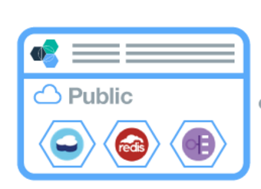




Architecture and Data Flow
Data Scientist
Workbench
Datasources
Prediction
Webservice API
Score
History
Node.js app
Continous sampling during games
Load
Export
Model
And refined
Data sets
publish
Odds
History
Once/day sample
Transformation, Analysis and
Modeling
Notes:
http://www.oddsmaker.ag/rss-feeds
http://www.referincome.com/odds/rss2/basketball_nba.xml
http://sports.espn.go.com/nba/bottomline/scores
For parsing espn scores, copied and modified a script by Josh Fuerst
Custom scripts to extract data run on local machine and copied to DSWB ..
Cue up these pages DSWB / BMIX dashboard / nba-rt-pred / localhost ….

Slide 8

Tooling
Data Acquisition | Analysis / Modelling | Operationalize
Custom scripts running on a server during the month of April Python / Bash | Data Scientist Workbench Zeppelin Notebook Spark MLLIB + Logistic + Dataframe Scala | Bluemix Node.js Bootstrap Javascript
Notes:
Make speaker notes

Slide 9

Brief Machine Learning Primer
Machine learning is the application of a broad class of algorithms that allow machines to ‘learn’ over time. As opposed to traditional computer programs that have very deterministic behavior, this concept embodies the notion that computers adapt to new data over time, even unexpected data
Examples of machine learning are wide ranging :
Autonomous cars
Fraud Detection
Stock Market Forecasting
Artificial Intelligence
Computer vision
…

Slide 10
Supervised and Unsupervised Learning
Machine learning algorithms breakdown into two categories :
Supervised learning : These algorithms use ‘labeled’ data where there are multiple inputs(features) used with one target or labeled data value that is to be predicted. Classification algorithms fall into this category.
Unsupervised learning : These algorithms try to find structure in the underlying data without a specific target variable. Algorithms in this category include clustering and anomaly detection.
Unsupervised learning
Supervised learning
Anomaly
Detection
Kmeans
Logistic Regression
Linear
Regression
PCA reduction
SVD
SVM
Classification
Naïve Bayes
Neural Networks

Slide 11
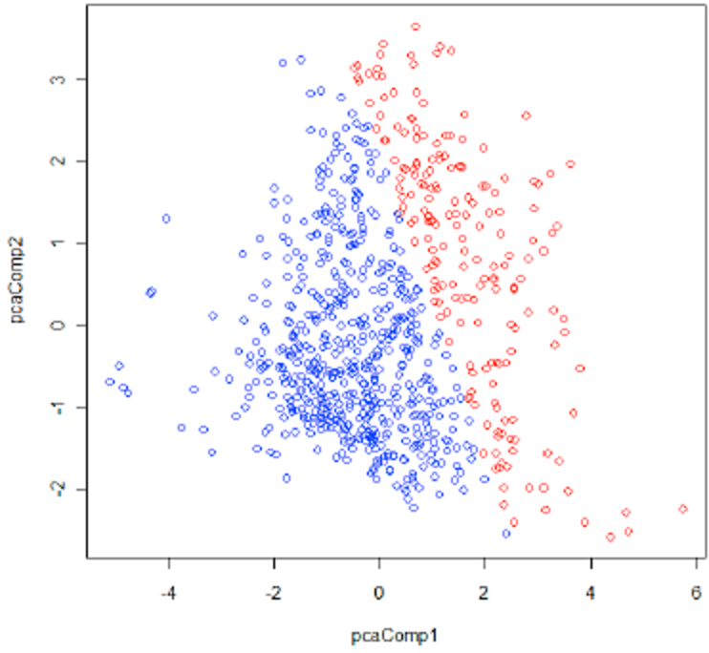
Regression and Classification
Regression algorithms are used to try to predict a relationship between a dependent value and one or more independent values
Typically used to model continuous outcomes eg. Housing prices, basketball scores
Classification aims to divide items into categories
The most common classification type is binary classification, where there are two categories
If there are more than two categories, it is called multiclass classification
Logistic regression is a popular method to predict a binary response
It is a special case of Generalized Linear models that predict the probability of an outcome
Binary logistic regression can be generalized into multinomial logistic regression to train and predict multiclass classification problems
The current implementation of logistic regression in spark.ml only supports binary classes. Support for multiclass regression will be added in the future.
Example of logistic regression

Slide 12
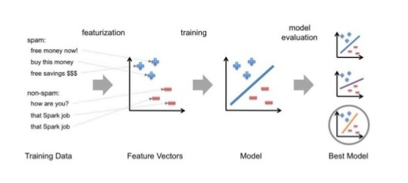
Typical Steps in ML Pipeline

Slide 13

What is Spark?
Spark is an open source
in-memory
application framework for
distributed data processing and
iterative analysis
on massive data volumes

Slide 14
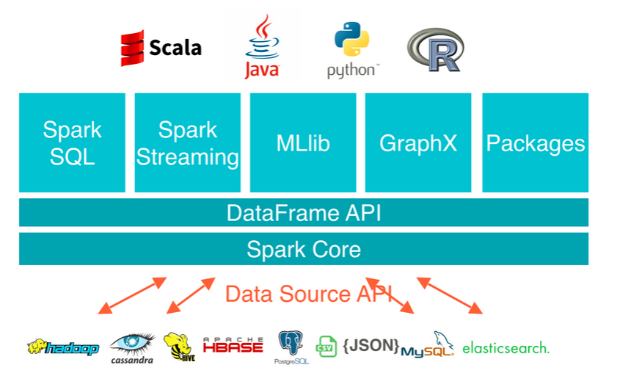
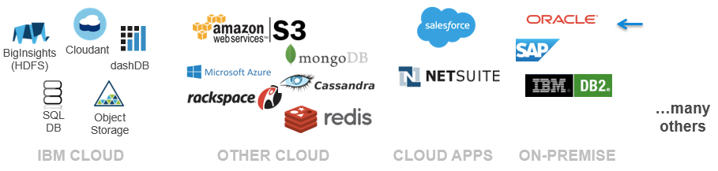
Apache Spark

Slide 15
Spark Capabilities
Spark Core
Spark Streaming
Stream Processing
Micro-batch event processing for near real-time analytics
Process live streams of data (IoT, Twitter, Kafka)
No multi-threading or parallel processing required
Near real-time data processing & analytics
MLlib (machine learning)
Machine Learning
Predictive and prescriptive analytics, and smart application design, from statistical and algorithmic models
Algorithms are pre-built
Incredibly fast, easy to deploy algorithms
Spark SQL
Unified Data Access
Query your structured data sets with SQL or other dataframe APIs
Data mining, BI, and insight discovery
Get results faster due to performance
Fast, familiar query language for all data
Log processing
TBD
GraphX (graph)
Graph Analytics
Represent data in a graph
Represent/analyze systems represented by nodes and interconnections between them
Transportation, person to person relationships, etc.
Fast and integrated graph computation

Slide 16
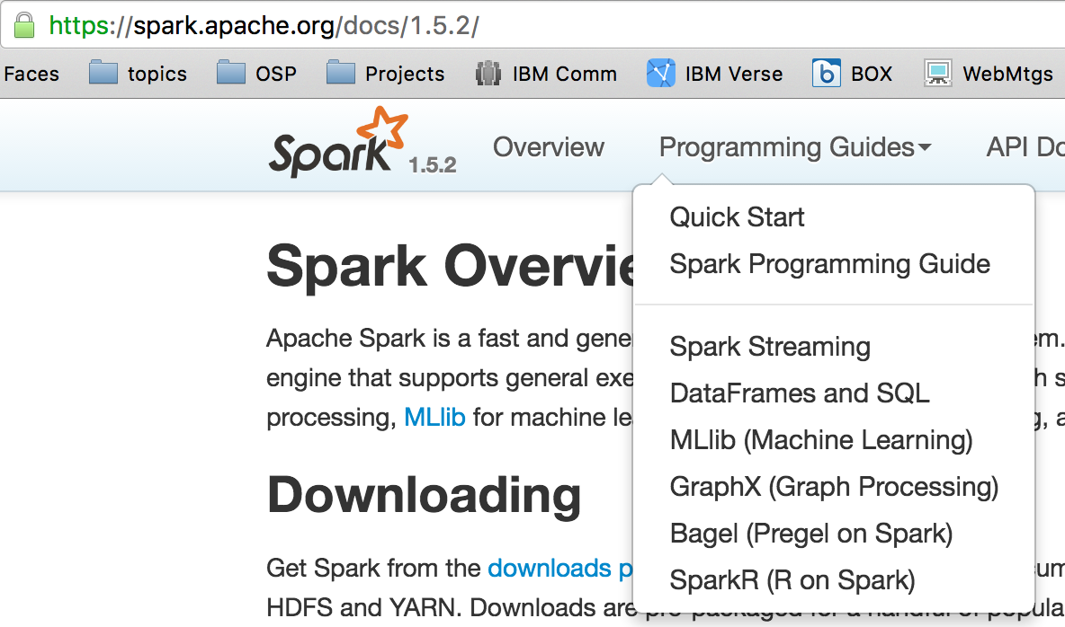
Spark MLlib
MLlib is Spark’s machine learning (ML) library
Its goal is to make practical machine learning scalable and easy
Consists of common learning algorithms and utilities, including
Classification
Regression
Clustering
Collaborative filtering
Dimensionality Reduction
Lower-level optimization primitives
Higher-level pipeline APIs
Check out apache.spark.org for more information

Slide 17

Spark MLlib
Divides into two packages:
spark.mllib contains the original API built on top of RDDs
spark.ml provides higher-level API built on top of DataFrames for constructing ML pipelines
Using spark.ml is recommended because with DataFrames the API is more versatile and flexible
spark.mllib will continue to be supported

Slide 18
Spark ML Pipeline Terminology
Spark ML standardizes APIs for machine learning algorithms to make it easier to combine multiple algorithms into a single pipeline, or workflow
DataFrame: Spark ML uses DataFrame from Spark SQL as an ML dataset, which can hold a variety of data types
Transformer: A Transformer is an algorithm which can transform one DataFrame into another DataFrame
Estimator: An Estimator is an algorithm which can be fit on a DataFrame to produce a Transformer
Pipeline: A Pipeline chains multiple Transformers and Estimators together to specify an ML workflow
Parameter: All Transformers and Estimators share a common API for specifying parameters
Evaluator: Not part of pipeline API but can be used to evaluate model goodness of fit

Slide 19
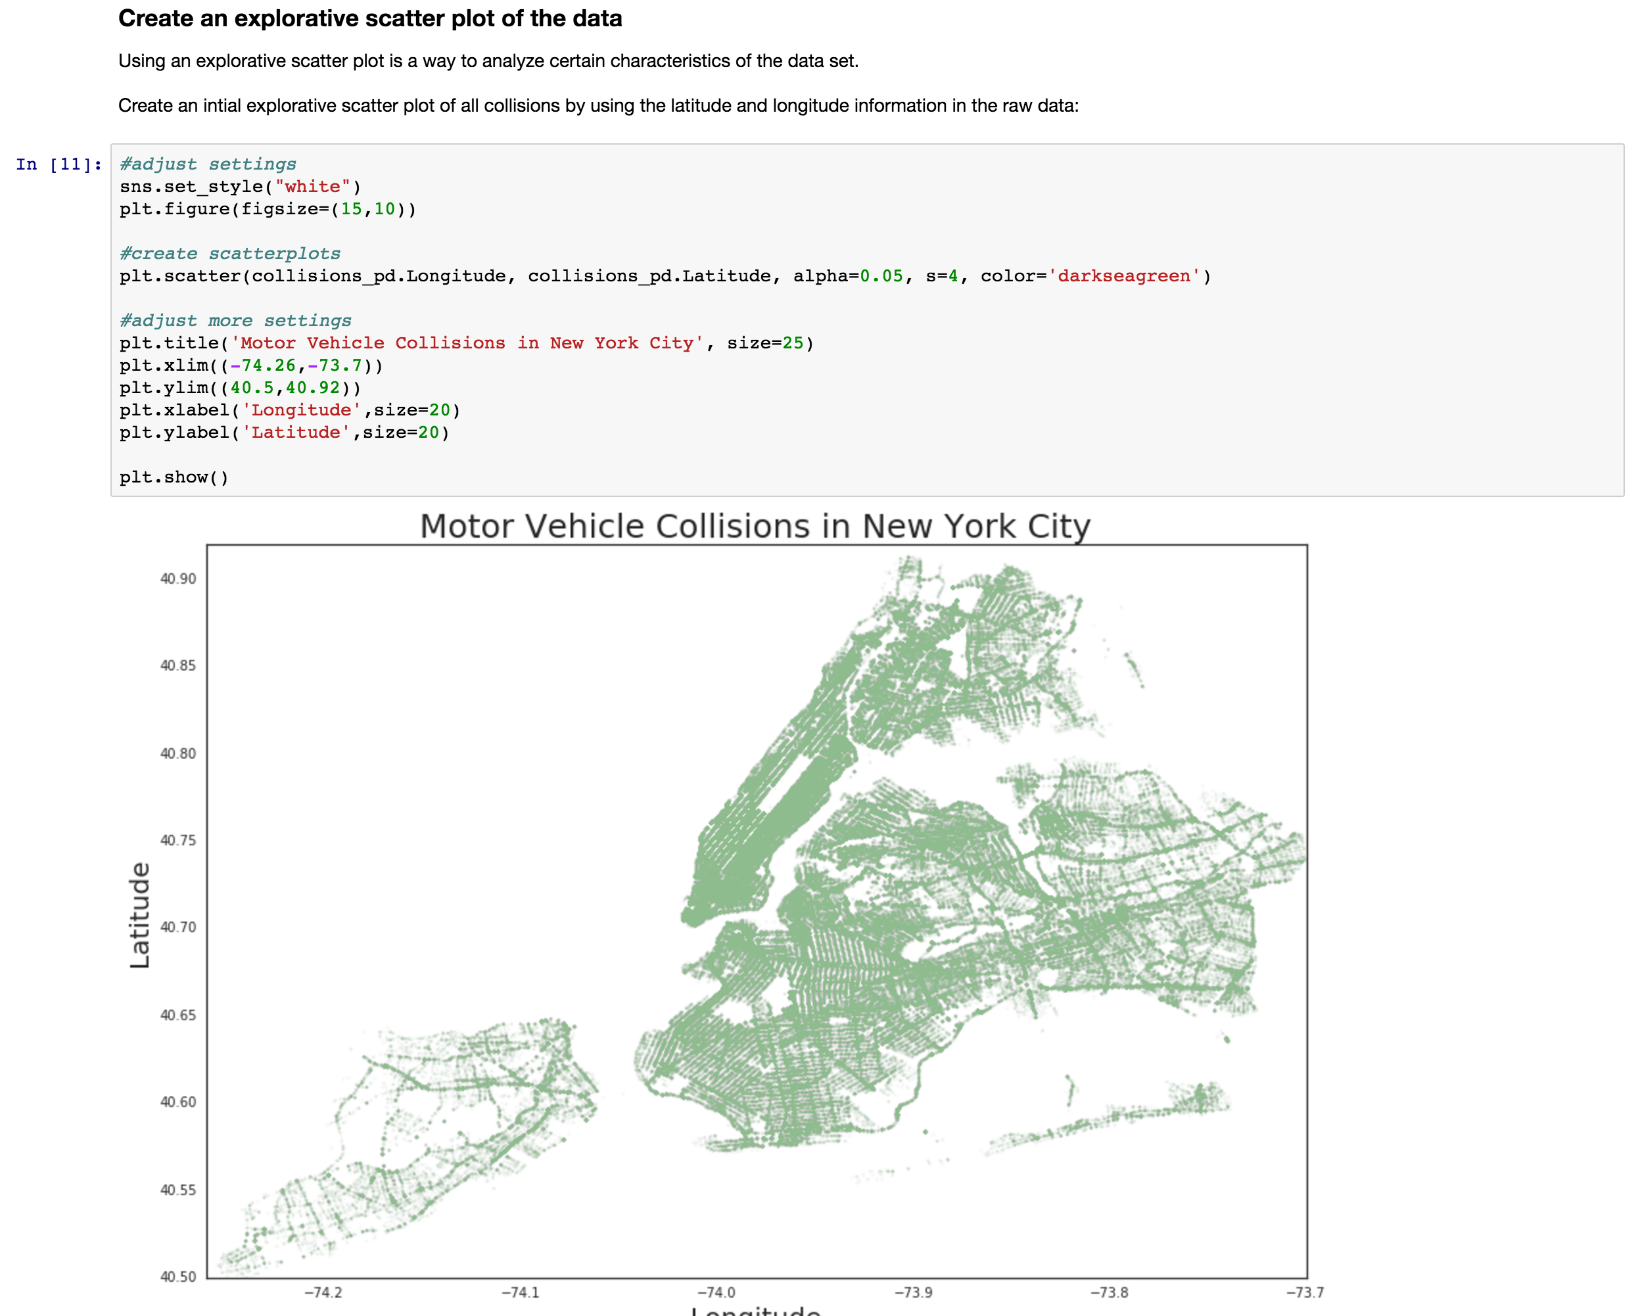


Jupyter and Zeppelin Notebooks Integrate with Spark
A web-application
Browser based development environment
A way of saving and presenting data analysis
Easy to share and reproduce work
Self documenting
Iterative development
A Few of the Popular notebooks include zeppelin, jupyter, and Rstudio

Slide 20
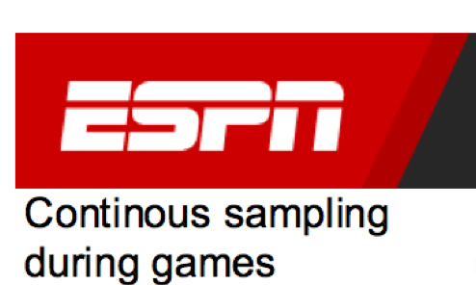
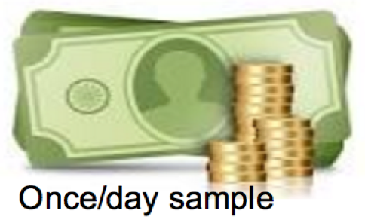
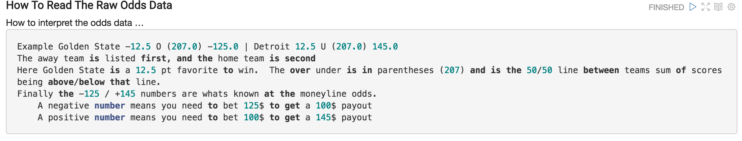
Use Case Input Data – 2 Data Sets
Raw Scores Format
2016-04-05,19:23:42,New Orleans,23,Philadelphia,12,(4:39 IN 1ST),40.65,400829041
2016-04-05,19:36:06,New Orleans,31,Philadelphia,23,(11:14 IN 2ND),35.2333333333,400829041
2016-04-05,19:36:21,New Orleans,33,Philadelphia,23,(10:55 IN 2ND),34.9166666667,400829041
2016-04-05,19:36:36,New Orleans,33,Philadelphia,23,(10:52 IN 2ND),34.8666666667,400829041
2016-04-05,19:36:52,New Orleans,33,Philadelphia,25,(10:48 IN 2ND),34.8,400829041
2016-04-05,19:37:38,New Orleans,33,Philadelphia,27,(10:07 IN 2ND),34.1166666667,400829041
2016-04-05,19:38:23,New Orleans,33,Philadelphia,29,(9:53 IN 2ND),33.8833333333,400829041
2016-04-05,19:42:10,New Orleans,33,Philadelphia,32,(9:02 IN 2ND),33.0333333333,400829041
2016-04-05,21:22:09,New Orleans,93,Philadelphia,107,(FINAL),0.0,400829041
Script used to scrape scores continuously every 30 secs
Data saved if score changed
Vegas odds format
<title>New Orleans 2.5 O (207.0) 125.0 | Phila. -2.5 U (207.0) -145.0 (Apr 05, 2016 07:10 PM)</title>
<title>Detroit 4.0 O (202.0) 160.0 | Miami -4.0 U (202.0) -190.0 (Apr 05, 2016 08:05 PM)</title>
<title>Charlotte 4.0 O (200.5) 155.0 | Toronto -4.0 U (200.5) -175.0 (Apr 05, 2016 07:40 PM)</title>
<title>Phoenix 14.5 O (207.5) -110.0 | Atlanta -14.5 U (207.5) -110.0 (Apr 05, 2016 08:10 PM)</title>
<title>Chicago -3.0 O (201.5) -150.0 | Memphis 3.0 U (201.5) 130.0 (Apr 05, 2016 08:10 PM)</title>
** Data was sampled for month of April 2016 only **
Notes:
The “key” will be to parse this data and later join iT!

Slide 21
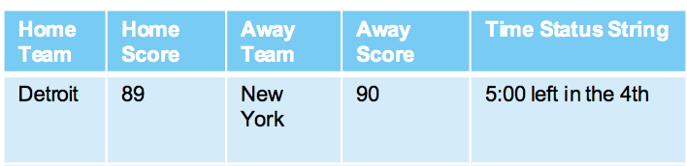
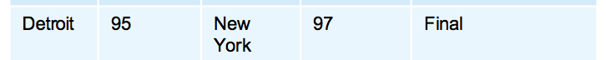
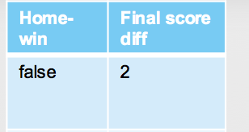
Data wrangling in notebook .
Step 1. Build score history data set with final score outcomes
Score history
100+ records per game
Add Extra Features
Replicate this for every in game data point

Slide 22
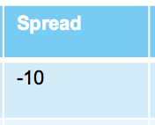
Odds History
Data wrangling in notebook .
Step 2. Merge in odds data
Home Team | Spread | Away Team
Detroit | -10 | New York
Chicago | 5 | Portland
…
1 record per game
join
Data Layout from Step 1
Home Team | Home Score | Away Team | Away Score | Time Status String | Final Score Home | Final Score Away | Winner
Detroit | 89 | New York | 90 | 5:00 left in the 4th | 95 | 97 | Knicks
…
Approx 100 records per game

Slide 23
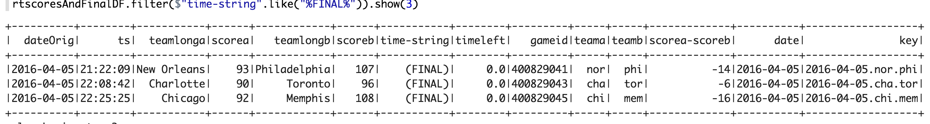
Add a ‘key’ column to historical score
Key will be of the form : date.awayTeam.homeTeam
Score data was loaded into rtscoresAndFinalDF dataframe
withColumn creates a new column called key
Logic that concatenates existing columns into a new string
Results

Slide 24
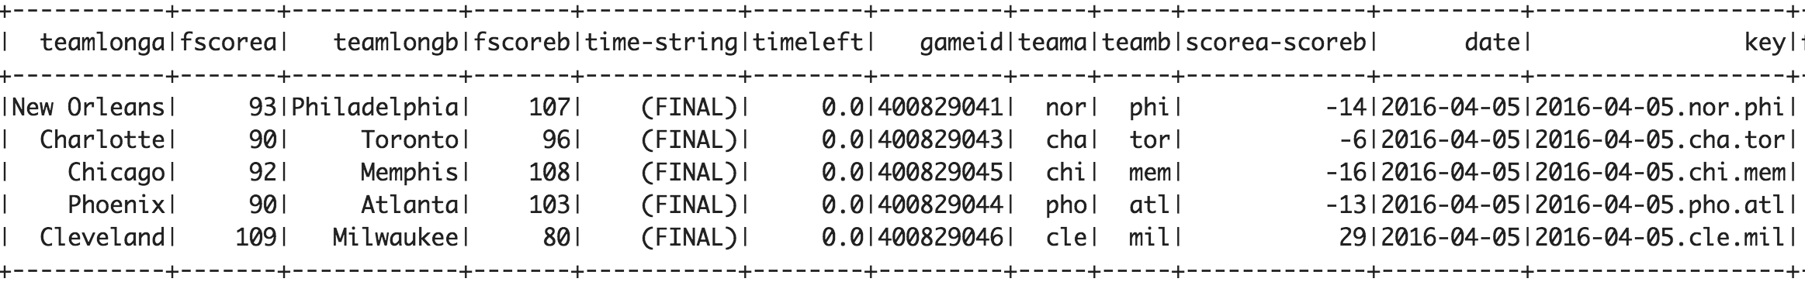
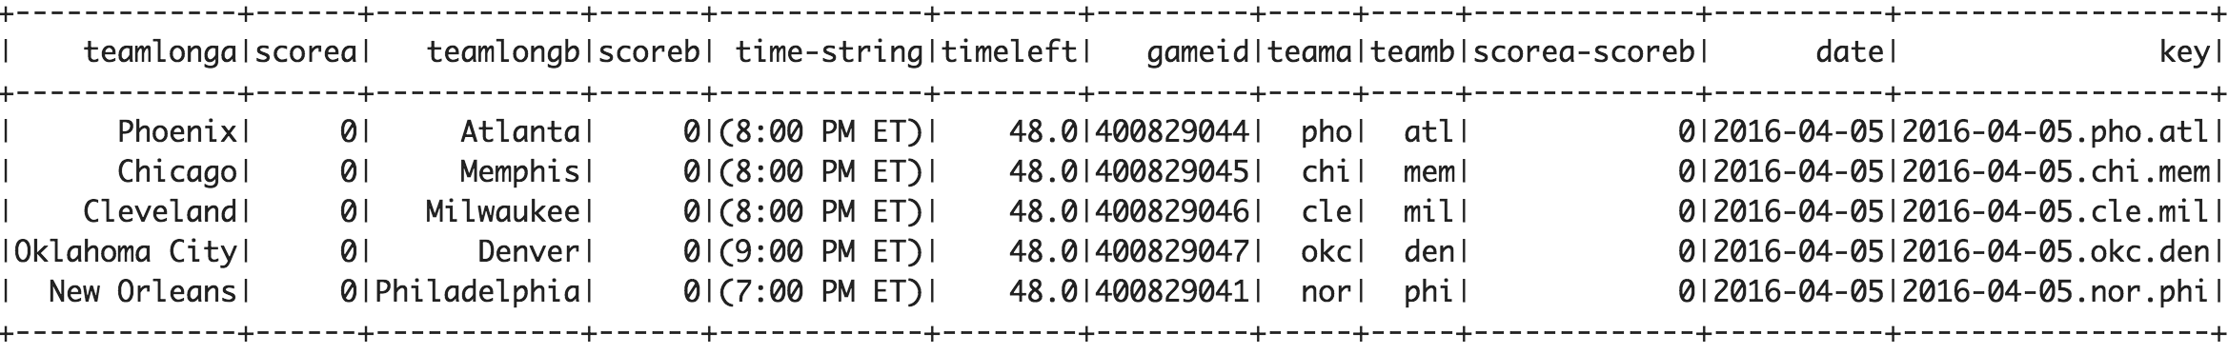
Split historical score dataframe into 2 dataframes
Score data was loaded into rtscoresAndFinalDF dataframe
Filter transformation splits the data sets
Column that we apply the filter criteria to $”..” is shorthand for df.colname
Filter Predicate
Results
finalscoresDF
Count = 113
rtscoresDF
Count = 13927

Slide 25
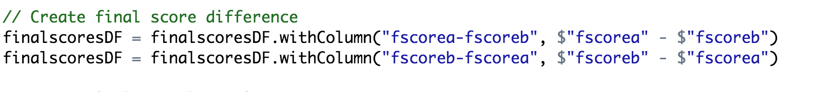
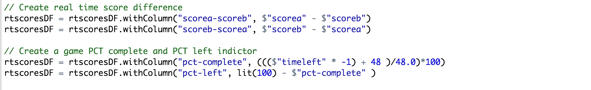
Add a couple of custom features
Here we have a few examples of adding new columns based on existing columns …
This column is important, as it will be our label we try to predict in logistic regression model
** Note : as a convention the ‘a’ team is away , the ‘b’ team is home

Slide 26
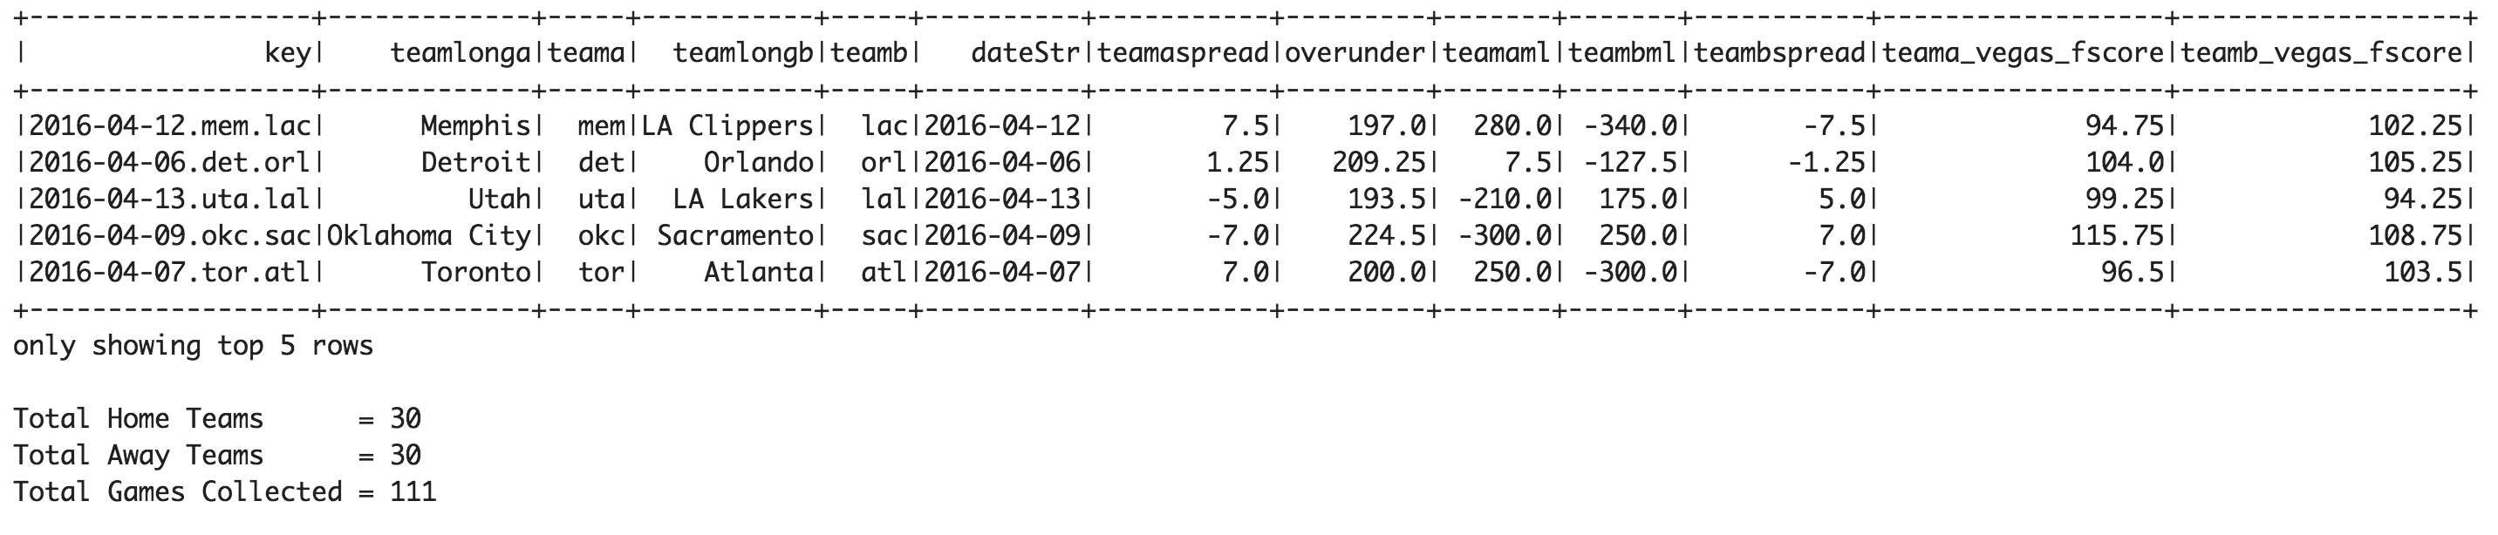
Odds Data custom parsing
Recall the odds data was not a simple csv file..
For scenarios like this, you need to read the data into an RDD and perform some custom parsing
Insert custom parsing code here (use scala string funcs like substring, lastIndexOf, length, split )
Quite an awful experience!
After lots and lots of string parsing and debug, you should get something like this ….

Slide 27
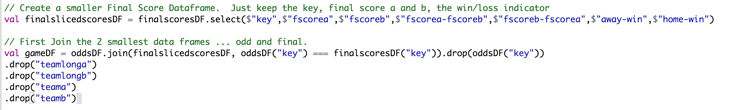
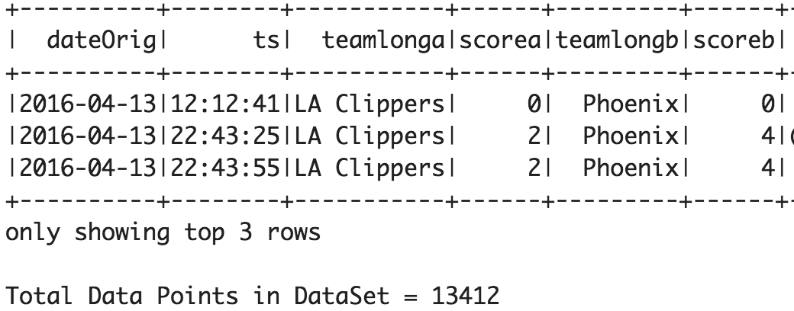
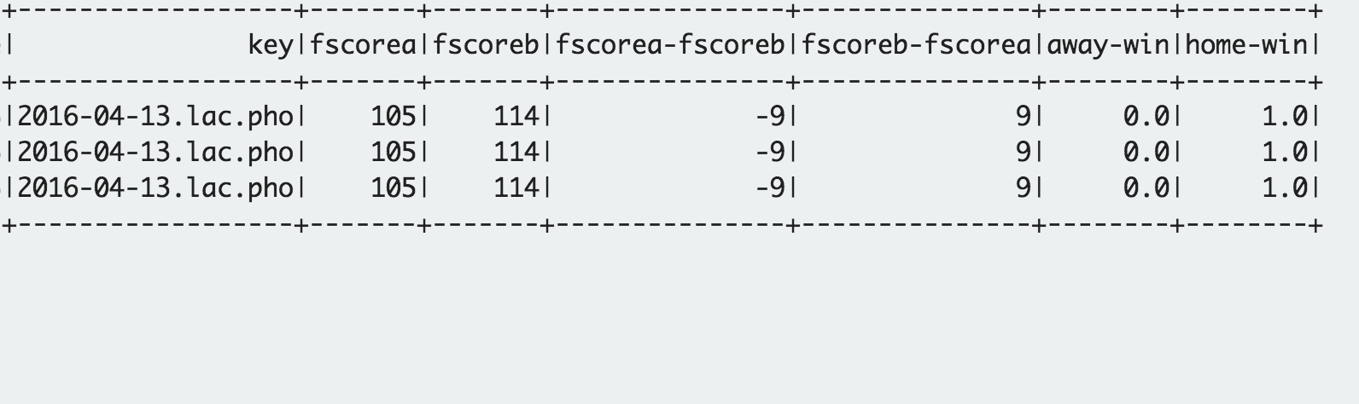

Join the data into final set
Step 1. Join the ’final’ scores and odds data on key column. There is one row per game
Step 2. Join gameDF frame from above, with the historical scores. There is one row for each score update
Result – each row now has current score, and the final outcome! We are ready for some ML now
… (many cols not shown)

Slide 28
Notebook visuals demo

Slide 29
Logistic Regression Example
Training
Data Set
assembler
Standard
Scaler
Logistic
Regression
Model Fit
Model
Weights
Data Set
split
Test Data Set
Transform
Predictions
Evaluate
In the next few slides we review a few key examples
* For simplicty is an example omits cross validation

Slide 30
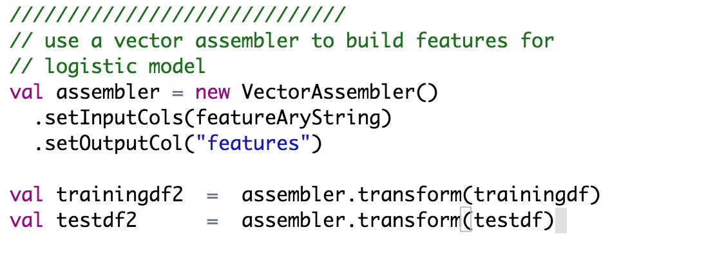
Logistic Regression Example
Training
Data Set
assembler
Standard
Scaler
Logistic
Regression
Model Fit
Model
Weights
Data Set
split
Test Data Set
Transform
Predictions
Evaluate
Prior to fitting a model, there must be a features column of type Vector, and a label column.
The assembler routine makes this easy by creating a features column, and packing the vector with the specified columns
Feature Array passed in e.g.

Slide 31
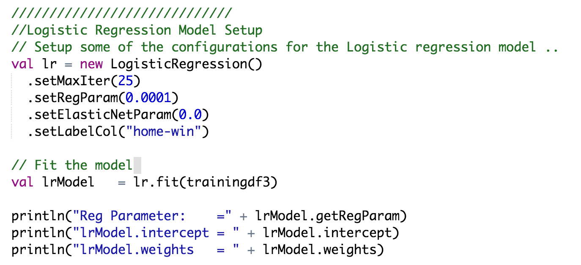
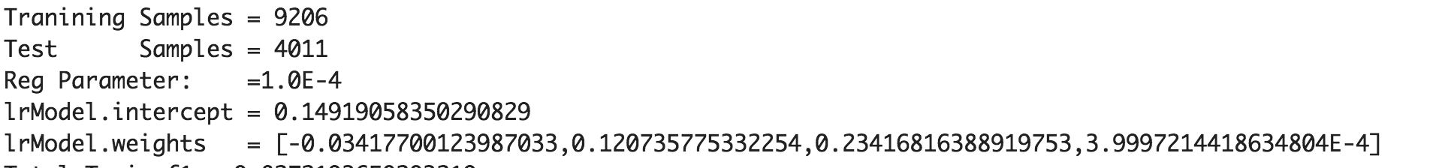
Logistic Regression Example
Training
Data Set
assembler
Standard
Scaler
Logistic
Regression
Model Fit
Model
Weights
Data Set
split
Test Data Set
Transform
Predictions
Evaluate
When fitting a model, there are some configuration options like regularization
For this example, I manually tuned this value. Using a cross validator, you can auto-mate this step
Whats key for this example, is extracting the intercept and weights of the model.
These values are used to implement logistic regression in our web service

Slide 32
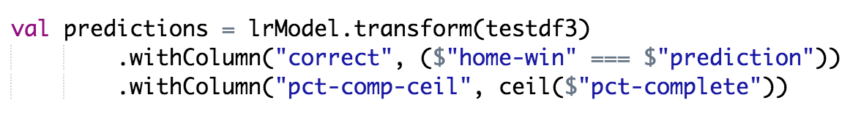
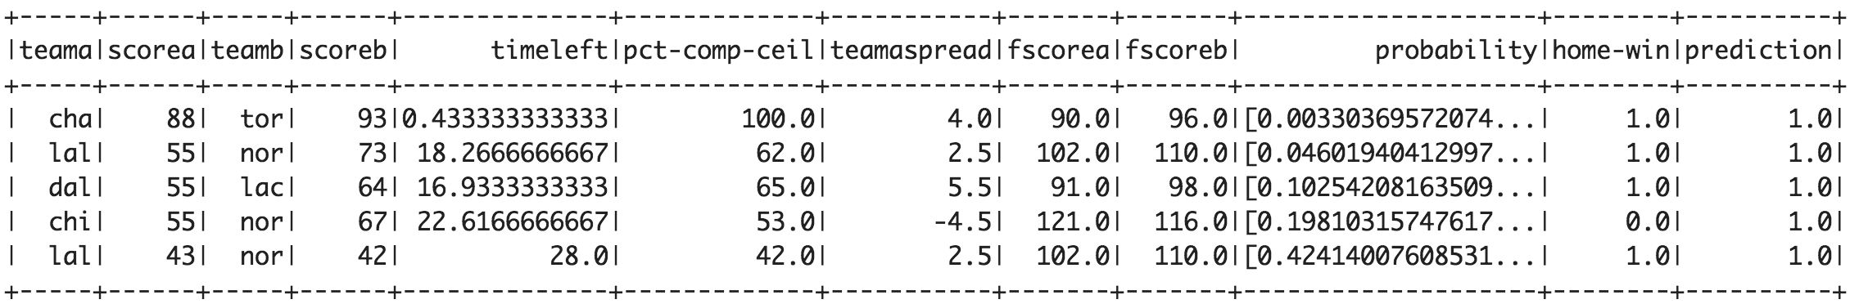
Logistic Regression Example
Traingin
Data Set
assembler
Standard
Scaler
Logistic
Regression
Model Fit
Model
Weights
Data Set
split
Test Data Set
Transform
Predictions
Evaluate
Transform – here we pass the test data frame into the model, and get a new dataframe with a probability/prediction column added

Slide 33
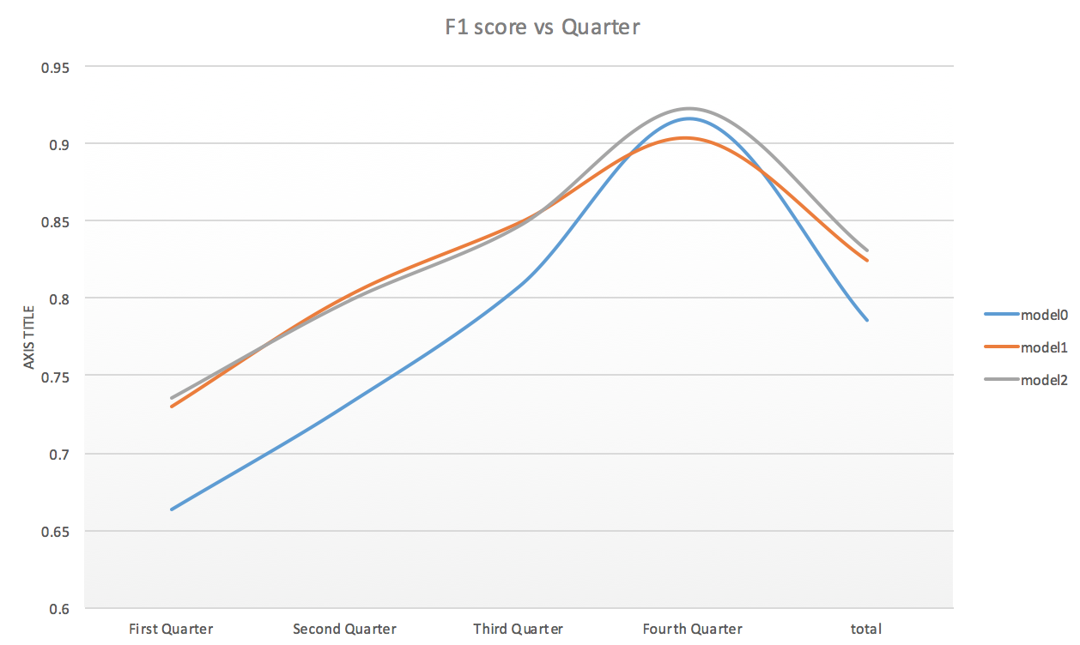
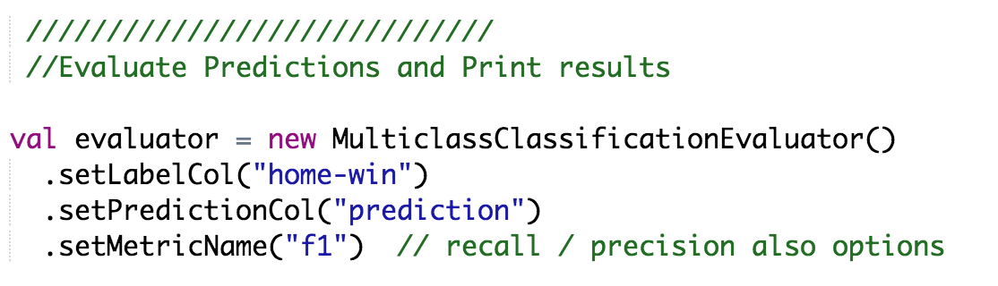
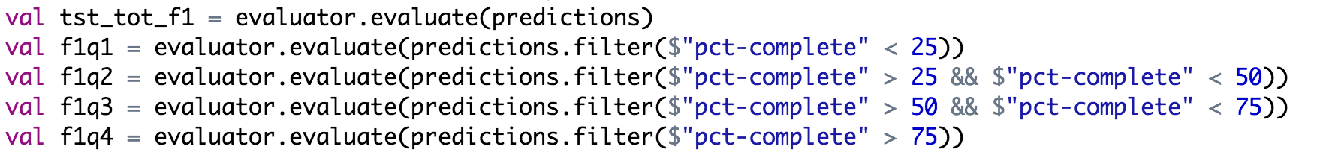
Logistic Regression Example
Traingin
Data Set
assembler
Standard
Scaler
Logistic
Regression
Model Fit
Model
Weights
Data Set
split
Test Data Set
Transform
Predictions
Evaluate
Setup an evaluator to measure F1 score ( F1 = 1 is error free)
Record F1 score for full game, and quarters
Here, the largest performance gain came from adding spread ….
Of course as game gets closer to end, predictions are better also

Slide 34

What is Node.js?
A server side framework for building fast scalable network applications
Event driven / Non blocking IO / no buffering
Can be used to connect to a number of backend systems
Leverages Javascript for coding
Tons of libraries available
Can easily implement REST API using express library
Node.js framework is a service available on Bluemix…
Lets check it out

Slide 35
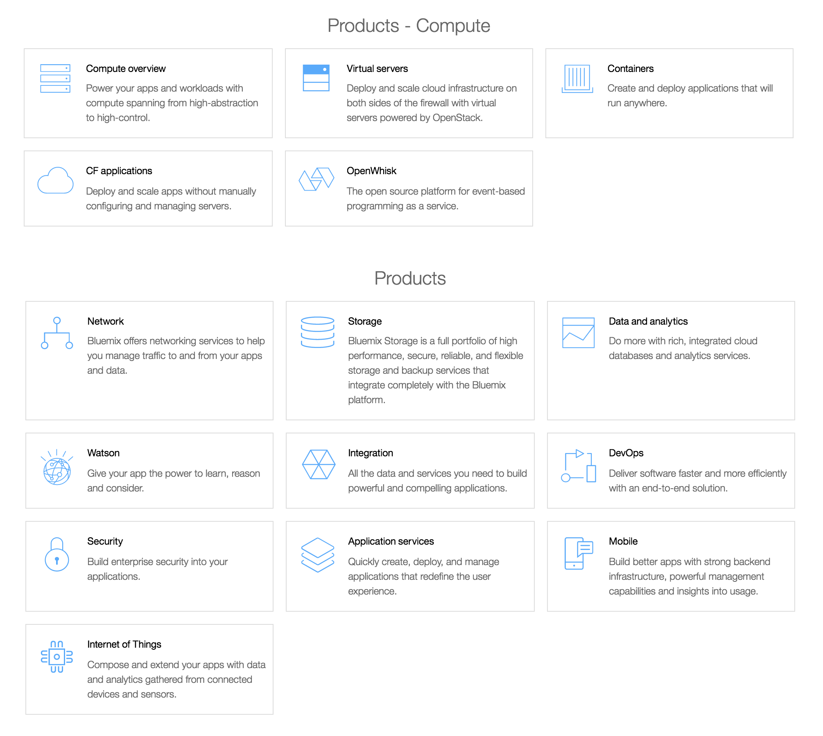

What is Bluemix?
IBM’s Platform as a service
Get a Free account here
www.ibm.com/Bluemix
Spark as a Service
Database options
Containers
VM’s
Watson
and more !
Notes:
Deploy the service now … while it is deploying, explain the next slide

Slide 36
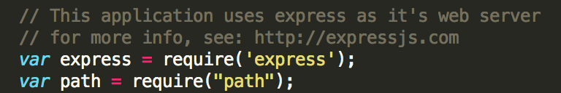
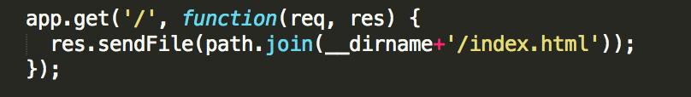
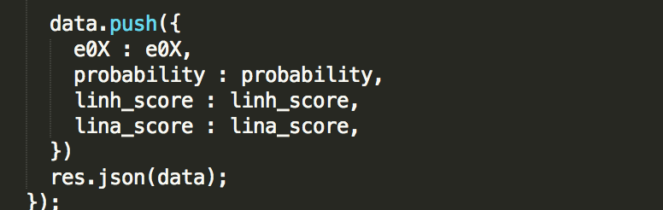
Web app layout / apps.js snippets
In github nodejs zip file there are three main source files
app.js : node.js application
public/index.html : web app home page
public/rtp.js : web app javascript
A couple app.js snippets
express library implements http rest services
/ endpoint serves up index.html
/scorepredictionv2 implements the score service
Data return in json format to client
Notes:
After this slide, now copy your dir to /tmp and push to bmix

Slide 37
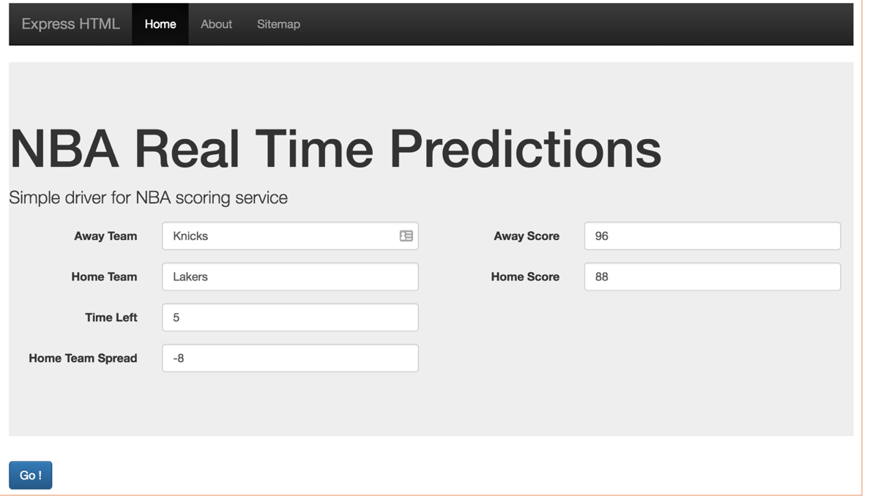
Node.js Communication Diagram
Client Browser
Node.js : nba-rt-prediction.bluemix.net
1) Browser navigates to URL:/
2) Server responds with HTML+Javascript
3) User moves the sliders
4) javascript runs a routine that requests a
score prediction via URL endpoint /scorepredictionv2
5) Server responds with JSON
6) Client renders the result

Slide 38
Switch over a sample deploy of the app to Node.js

Slide 39

General Experiences …..
A great ML idea with no data is useless ….
A few resources that helped me
Coursera Machine Learning Course – Andrew Ng
Kaggle.com for ideas and great data sets
Youtube has so many awesome videos on scala, node.js, bootstrap.
Spark user mailing list
While model building can be CPU/RAM intensive, model scoring can be fairly lightweight.
Use clusters to build models
Scoring could/can be done with far fewer resources and is usually a different platform
Porting model code from Spark to Node.js can be error-prone.
Some better methods I plan to explore
Use a lightweight eclairjs instance
(opensource project from IBM that integrates node.js and spark)
Implement models using Rstudio and use Shiny app
Spark streaming, but latency could be an issue
ML persistence (model export / import) to other platforms like IBM streams

Slide 40
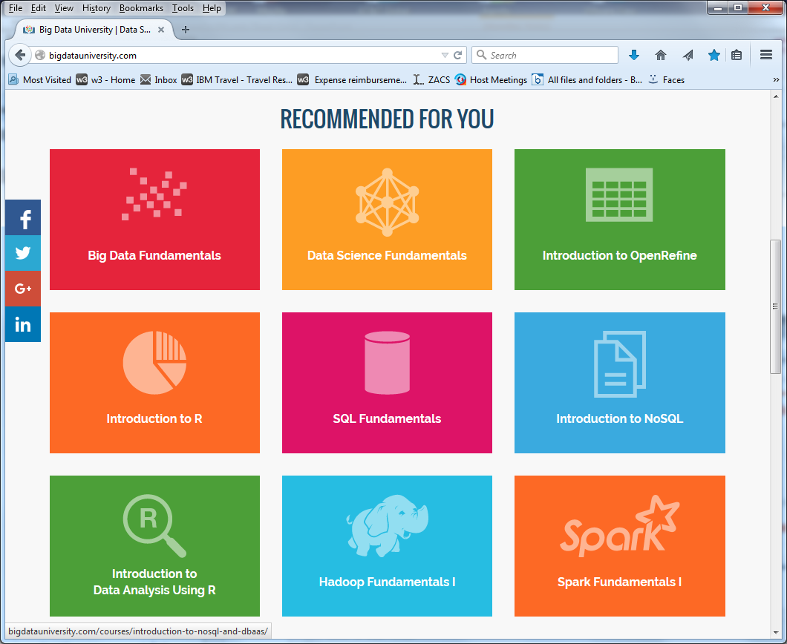
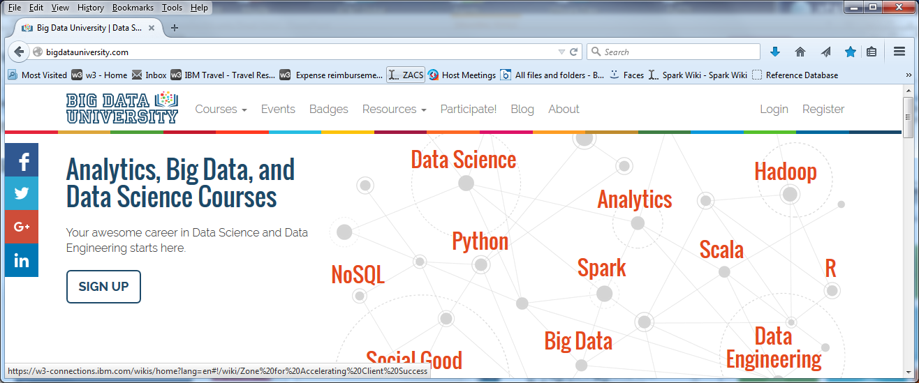
Want to learn more ?
Big Data University
http://bigdatauniversity.com/

Slide 41
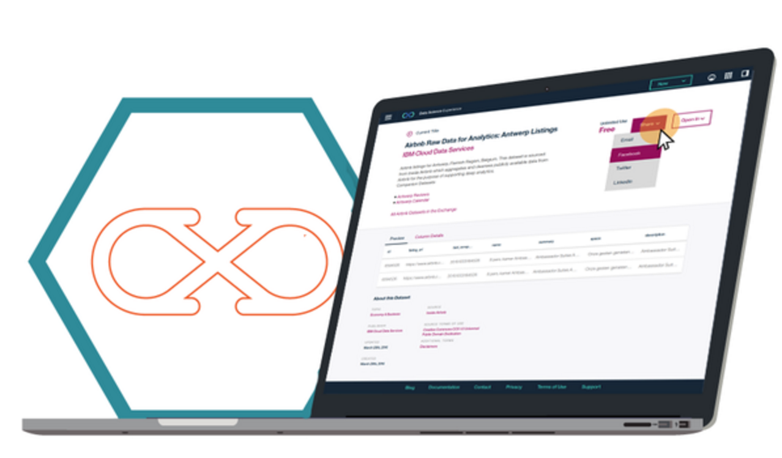
Engage with us!
IBM has an excellent array of offerings on cloud (freemium, pay-go, monthly) and on premise!
Data Scientist Experience (DSX)
IBM’s newly release Data Science platform!
http://datascience.ibm.com/
BigInsights on Bluemix/Softlayer
Spark on Bluemix
Spark Technology Center
spark.tc
Contact : vanstee@us.ibm.com

Slide 42


Slide 43
General Experiences (cont)…..
Roughly 80% of my time for this project was spent prepping and filtering out bad data and coming up with custom features
Notebook interface greatly accelerated my dev cycle
Wasted a lot of time before I figured out the difference between spark.ml spark.mllib libraries
Spark.ml is newer and works with dataframes. Use this where you can …
Make sure you know the EXACT version of spark on your cloud service. It matters since the API is updated frequently
Building services around your models are a great way to let users get intuition around data science with fairly low friction
Coding with Scala was an experiment for me , but I am thinking R would be much better suited for a lot of the examples I had here
Scala has a level of syntax you must overcome
R is statistical language and very well developed for that usage
its the defacto standard tool used by most data scientists

